Slide 1
Chapter 5: Optimizing Code Performance
Topics
Machine-Independent Optimizations
Code motion
Reduction in strength
Common subexpression sharing

Slide 2
Announcements
Attack Lab #3 grading during this week
Recitation exercise released, due next week
Performance Lab #4 available, due Monday November 13
Optimize code to improve performance
Read:
Chapter 5
Do practice problems

Slide 3
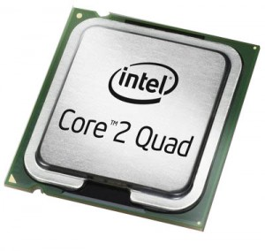
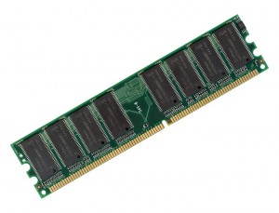
Chapter Mapping
Chapter 3
add a,b
sub a,b
Chapter 7
move a…
Lines of
Source
code
Pre-processor
&
Compiler
Lines of
Assembly
code
Assembler
&
Linker
Chapter 8
Chapter 2
Chapter 2
Chapter 5
Operating
System
10101010
00001010
Chapter 9
01010111
10101010
Lines of
Binary
code &
data
Memory
11101110
Chapters 3, 4, 5 and 6
00111011
10000111

Slide 4
Optimizing Compilers
Everyone wants their code to run faster
Web site servers and Web browsers
“Big Data” mining in cloud computing
Scientists running massive atmospheric simulations
Mobile clients – rendering a pinch-and-zoom UI
Can compile code with different optimization levels
-O1, -O2, -O3
Compiler applies different transformations to source code to try and make the code run faster
Code motion
Reduction in strength
Common subexpression sharing
Notes:
-O2 is a superset of –O1 optimizations, -O3 is a superset of –O2 optimizations, generally, higher-level optimizations require more advanced optimization techniques, and don’t always improve program speed. By default, if no -Ox flag is specified then -O0 (essentially no optimizations) is assumed. See also http://www.redhat.com/magazine/011sep05/features/gcc/.

Slide 5
Limitations of Optimizing Compilers
Operate Under Fundamental Constraint
Must not cause any change in program behavior under any possible condition
Often prevents it from making optimizations when would only affect behavior under pathological conditions.
Behavior that may be obvious to the programmer can be obfuscated by languages and coding styles
e.g., data ranges may be more limited than variable types suggest
Most analysis is performed only within procedures
whole-program analysis is too expensive in most cases
Most analysis is based only on static information
compiler has difficulty anticipating run-time inputs
When in doubt, the compiler must be conservative
potential memory aliasing
potential procedure side-effects
Notes:
Newer versions of GCC do interprocedural analysis within individual files But, not between code in different files

Slide 6
Optimization Blocker: Memory Aliasing
Memory Aliasing – two pointers point to or alias the same memory location
void fun1(int *xp, int *yp)
{
*xp += *yp; // line 1
*xp += *yp; // line 2
}
void fun1(int *xp, int *yp)
{
*xp += 2* *yp;
}
?
If xp==yp,
then *xp = 2* *xp after line 1
and *xp = 4* *xp after line 2
If xp==yp,
then *xp = 3* *xp
Compiler must be conservative and not blindly apply optimizations, in this case withholding optimization in case the pointers are aliased

Slide 7
Optimization Blocker: Procedure Side-Effects
Function modifies some part of the global program state
int f();
void fun1(int *xp, int *yp)
{
return f()+f()+f()+f()
}
int f();
void fun1(int *xp, int *yp)
{
return 4*f();
}
?
Suppose f() increments a global counter
then above fun1() will increment counter 4 times
But above “optimized” fun1()
will increment counter only once!
Compiler must be conservative and not blindly apply optimizations, in this case because of functional side effects
Most compilers don’t try to determine whether a function is free from side effects

Slide 8
Machine-Independent Optimizations
Optimizations you should do regardless of processor / compiler
Usually handled by compiler
Code Motion
Reduce frequency with which computation performed
If it will always produce same result
Especially moving code out of loop
for (i = 0; i < n; i++) {
int ni = n*i;
for (j = 0; j < n; j++)
a[ni + j] = b[j];
}
for (i = 0; i < n; i++)
for (j = 0; j < n; j++)
a[n*i + j] = b[j];

Slide 9
Compiler-Generated Code Motion
Most compilers do a good job with array code + simple loop structures
Code Generated by GCC
for (i = 0; i < n; i++) {
int ni = n*i;
int *p = a+ni;
for (j = 0; j < n; j++)
*p++ = b[j];
}
for (i = 0; i < n; i++)
for (j = 0; j < n; j++)
a[n*i + j] = b[j];
imull %ebx,%eax # i*n outside of inner j loop
movl 8(%ebp),%edi # a
leal (%edi,%eax,4),%edx # p = a+i*n (scaled by 4)
# Inner Loop
.L40:
movl 12(%ebp),%edi # b
movl (%edi,%ecx,4),%eax # b+j (scaled by 4)
movl %eax,(%edx) # *p = b[j]
addl $4,%edx # p++ (scaled by 4)
incl %ecx # j++
jl .L40 # loop if j<n

Slide 10
Reduction in Strength
Replace costly operation with simpler one
Shift, add instead of multiply or divide
16*x --> x << 4
Utility is machine dependent
Depends on cost of multiply or divide instruction
On Intel Nehalem, integer multiply requires 3 CPU cycles
Recognize sequence of products
for (i = 0; i < n; i++) {
int ni = n*i;
for (j = 0; j < n; j++)
a[ni + j] = b[j];
}
for (i = 0; i < n; i++)
for (j = 0; j < n; j++)
a[n*i + j] = b[j];
int ni = 0;
for (i = 0; i < n; i++) {
for (j = 0; j < n; j++)
a[ni + j] = b[j];
ni += n;
}

Slide 11
Make Use of Registers
Reading and writing registers much faster than reading/writing memory
Limitation
Compiler not always able to determine whether variable can be held in register
Possibility of Aliasing
See example later

Slide 12
Share Common Subexpressions
Reuse portions of expressions
GCC will do this with –O1
/* Sum neighbors of i,j */
up = val[(i-1)*n + j];
down = val[(i+1)*n + j];
left = val[i*n + j-1];
right = val[i*n + j+1];
sum = up + down + left + right;
int inj = i*n + j;
up = val[inj - n];
down = val[inj + n];
left = val[inj - 1];
right = val[inj + 1];
sum = up + down + left + right;
3 multiplications: i*n, (i–1)*n, (i+1)*n
1 multiplication: i*n
leaq 1(%rsi), %rax # i+1
leaq -1(%rsi), %r8 # i-1
imulq %rcx, %rsi # i*n
imulq %rcx, %rax # (i+1)*n
imulq %rcx, %r8 # (i-1)*n
addq %rdx, %rsi # i*n+j
addq %rdx, %rax # (i+1)*n+j
addq %rdx, %r8 # (i-1)*n+j
imulq %rcx, %rsi # i*n
addq %rdx, %rsi # i*n+j
movq %rsi, %rax # i*n+j
subq %rcx, %rax # i*n+j-n
leaq (%rsi,%rcx), %rcx # i*n+j+n
leal -1(%edx),%ecx # i-1
imull %ebx,%ecx # (i-1)*n
leal 1(%edx),%eax # i+1
imull %ebx,%eax # (i+1)*n
imull %ebx,%edx # i*n

Slide 13
Optimization Example: Vector ADT
length
0
1
2
length–1
data
• • •
Procedures
vec_ptr new_vec(int len)
Create vector of specified length
int get_vec_element(vec_ptr v, int index, int *dest)
Retrieve vector element, store at *dest
Return 0 if out of bounds, 1 if successful
int vec_length(vec_ptr v)
Return length of vector
int *get_vec_start(vec_ptr v)
Return pointer to start of vector data
Similar to array implementations in Pascal, Java
e.g., always do bounds checking

Slide 14
Optimization Example
Procedure
Compute sum of all elements of vector
Store result at destination location
void combine1(vec_ptr v, int *dest)
{
int i;
*dest = 0;
for (i = 0; i < vec_length(v); i++) {
int val;
get_vec_element(v, i, &val);
*dest += val;
}
}
Pentium II/III Performance: Clock Cycles / Element (CPE)
42.06 (Compiled -g) 31.25 (Compiled -O2)
Notes:
-g produces debugging information

Slide 15
Cycles Per Element (CPE)
Convenient way to express performance of program that operators on vectors or lists
Length = n
T = CPE*n + Overhead
vsum1
Slope = 4.0
vsum2
Slope = 3.5
Notes:
If you have n elements of an array/vector, how many cycles does it take to process each element? That’s CPE. Typically, devise a loop that will process each element of the array. So CPE would seem to be equal to cycles per iteration. But loops can be unrolled, resulting in fewer iterations. We still care about the amount of computation it takes to process the N elements of the array/vector.

Slide 16
Understanding Loop
void combine1-goto(vec_ptr v, int *dest)
{
int i = 0;
int val;
*dest = 0;
if (i >= vec_length(v))
goto done;
loop:
get_vec_element(v, i, &val);
*dest += val;
i++;
if (i < vec_length(v))
goto loop
done:
}
1 iteration
Inefficiency
Procedure vec_length called every iteration
Even though result always the same

Slide 17
Procedure Calls are Expensive
Recall the steps to calling a procedure/function:
Prepare each parameter to pass to a procedure either by saving it in a CPU register or pushing it onto the stack
For N parameters, have to do this N times
Save any caller-save registers
Push the return address on the stack.
Decrement stack pointer
Save any callee-save registers
Allocate local variables
Recall the steps to exiting a procedure/function:
Restore callee-save registers
Pop return address from stack and jump to it
Restore caller-save registers
Notes:
This doesn’t include extra steps such as checking the canary on exit.

Slide 18
Move vec_length Call Out of Loop
Optimization
Move call to vec_length out of inner loop
Value does not change from one iteration to next
Code motion
void combine2(vec_ptr v, int *dest)
{
int i;
int length = vec_length(v);
*dest = 0;
for (i = 0; i < length; i++) {
int val;
get_vec_element(v, i, &val);
*dest += val;
}
}
CPE: 20.66 (Compiled -O2)
vec_length requires only constant time, but significant overhead

Slide 19
Code Motion Example #2
Procedure to Convert String to Lower Case
void lower1(char *s)
{
int i;
for (i = 0; i < strlen(s); i++)
if (s[i] >= ‘A’ && s[i] <= ‘Z’)
s[i] -= (‘A’ – ‘a’);
}
For a string of length n,
strlen() takes n steps
to search for ‘\0’, and
the loop calls strlen()
n times, so overall
complexity is n² ---
Quadratic!
void lower2(char *s)
{
int i;
int len = strlen(s);
for (i = 0; i < len; i++)
if (s[i] >= ‘A’ && s[i] <= ‘Z’)
s[i] -= (‘A’ – ‘a’);
}
Execute strlen() only
once outside of loop,
since result does not
change at each
Iteration.
Much more scalable!
Form of code motion

Slide 20
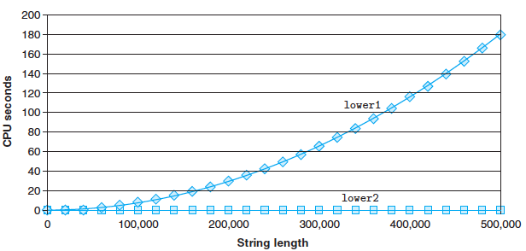
Lower Case Conversion Performance
Time quadruples when double string length
Quadratic performance

Slide 21
Optimization Blocker: Procedure Calls
Why couldn’t the compiler move vec_length or strlen out of the inner loop?
Procedure may have side effects
Alters global state each time called
Function may not return same value for given arguments
Depends on other parts of global state
Procedure lower could interact with strlen
Why doesn’t compiler look at code for vec_len or strlen?
Interprocedural optimization is not used extensively due to cost
Linker may overload with different version
Unless declared static
Warning:
Compiler treats procedure call as a black box
Weak optimizations in and around them

Slide 22
Optimization Blocker: Procedure Calls
Remedies:
Use of inline functions
GCC does this with –O1
Within single file
Do your own code motion
Notes:
Wikipedia: “In the C and C++ programming languages, an inline function is one qualified with the keyword inline; this serves two purposes. Firstly, it serves as a compiler directive that suggests (but does not require) that the compiler substitute the body of the function inline by performing inline expansion, i.e. by inserting the function code at the address of each function call, thereby saving the overhead of a function call.”

Slide 23
Reduction in Strength
void combine2(vec_ptr v, int *dest)
{
int i;
int stlength = vec_length(v);
*dest = 0;
for (i = 0; i < length; i++) {
int val;
get_vec_element(v, i, &val);
*dest += val;
}
}
void combine3(vec_ptr v, int *dest)
{
int i;
int length = vec_length(v);
int *data = get_vec_start(v);
*dest = 0;
for (i = 0; i < length; i++) {
*dest += data[i];
}
}
Optimization
Avoid procedure call to retrieve each vector element
Get pointer to start of array before loop
Within loop just do pointer reference
Not as clean in terms of data abstraction
CPE: 6.00 (Compiled -O2)
Procedure calls are expensive!
Bounds checking is expensive

Slide 24
Eliminate Unneeded Memory Refs
void combine4(vec_ptr v, int *dest)
{
int i;
int length = vec_length(v);
int *data = get_vec_start(v);
int sum = 0;
for (i = 0; i < length; i++)
sum += data[i];
*dest = sum;
}
void combine3(vec_ptr v, int *dest)
{
int i;
int length = vec_length(v);
int *data = get_vec_start(v);
*dest = 0;
for (i = 0; i < length; i++) {
*dest += data[i];
}
}
Optimization
Don’t need to store in destination until end
Local variable sum held in register
Avoids 1 memory read, 1 memory write per element
CPE: 2.00 (Compiled -O2)
Memory references are expensive!

Slide 25
Memory Accesses are Expensive
The computer’s main memory is 1000x more expensive to access in terms of latency than CPU registers
Speed of main memory is on the order of microseconds
Speed of CPU registers is on the order of nanoseconds
Hence, each memory access (read or write) means the CPU is sitting around wasting cycles waiting for the memory to respond
Global variables are stored in main memory, so accessing them is expensive
Since the call stack is located in main memory, then every access of the stack is expensive
Local variables
Parameters
Return addresses
Notes:
This doesn’t include extra steps such as checking the canary on exit.

Slide 26
Detecting Unneeded Memory Refs.
Combine3
Combine4
.L18:
movl (%ecx,%edx,4),%eax
addl %eax,(%edi)
incl %edx
cmpl %esi,%edx
jl .L18
.L24:
addl (%eax,%edx,4),%ecx
incl %edx
cmpl %esi,%edx
jl .L24
Performance
Combine3
5 instructions in 6 clock cycles
addl must read and write memory
Combine4
4 instructions in 2 clock cycles (we’ll see an example of how this is derived later in the class)

Slide 27
Optimization Blocker: Memory Aliasing
void combine3(vec_ptr v, int *dest)
{
int i;
int length = vec_length(v);
int *data = get_vec_start(v);
*dest = 0;
for (i = 0; i < length; i++) {
*dest += data[i];
}
Example
combine(v, dest)
Normally expect dest to be any pointer unrelated to v, but what if aliased?
v: [3, 2, 17]
combine3(v, get_vec_start(v)+2)→ ?
[3,2,0] before loop
[3,2,3] i=0
[3,2,5] i=1
[3,2,10] i=2, final
combine4(v, get_vec_start(v)+2)→ ?
[3,2,17] before loop
Sum updated to 22
[3,2,22] final
void combine4(vec_ptr v, int *dest)
{
int i;
int length = vec_length(v);
int *data = get_vec_start(v);
int sum = 0;
for (i = 0; i < length; i++)
sum += data[i];
*dest = sum;
}

Slide 28
Optimization Blocker: Memory Aliasing
Observations
Easy to have happen in C
Since allowed to do address arithmetic
Direct access to storage structures
Get in habit of introducing local variables, e.g. combine4()
Accumulating within loops
Your way of telling compiler not to check for aliasing

Slide 29
Machine-Independent Opt. Summary
Code Motion
Compilers are good at this for simple loop/array structures
Don’t do well in presence of procedure calls and memory aliasing
Reduction in Strength
Shift, add instead of multiply or divide
compilers are (generally) good at this
Exact trade-offs machine-dependent
Keep data in registers rather than memory
compilers are not good at this, since concerned with aliasing
Share Common Subexpressions
compilers have limited algebraic reasoning capabilities

Slide 30
Recap of Machine-independent Optimizations…
Improving software performance
Compilers must be cautious in their optimizations
Memory aliasing
Functional side effects
Optimizations
Code motion
Reduction in strength
Share common sub-expressions
CPE
Cycles/element
Optimization Example:
combine1 CPE=42
combine4
CPE=2
combine3
CPE=6
combine2
CPE=21
void combine1(vec_ptr v, int *dest)
{
int i;
*dest = 0;
for (i = 0; i < vec_length(v); i++) {
int val;
get_vec_element(v, i, &val);
*dest += val;
}
}

Slide 31
Unoptimized Baseline vs Optimized Code
void combine1(vec_ptr v, int *dest)
{
int i;
*dest = 0;
for (i=0; i<vec_length(v);
i++) {
int val;
get_vec_element(v,I,&val);
*dest += val;
}
}
void combine4(vec_ptr v, int *dest)
{
int i;
int length = vec_length(v);
int *data = get_vec_start(v);
int sum = 0;
for (i=0; i<length; i++) {
sum += data[i];
}
*dest = sum;
}

Slide 32
General Forms of Combining
void abstract_combine4(vec_ptr v, data_t *dest)
{
int i;
int length = vec_length(v);
data_t *data = get_vec_start(v);
data_t t = IDENT;
for (i = 0; i < length; i++)
t = t OP data[i];
*dest = t;
}
Data Types
Use different declarations for data_t
int
float
double
Operations
Use different definitions of OP and IDENT
+ / 0
* / 1

Slide 33
Machine Independent Opt. Results
Optimizations
Reduce function calls and memory references within loop
Floating Point
X
41.86
33.25
21.25
9.00
4.00
+
41.44
31.25
21.15
8.00
3.00
X
160.00
143.00
135.00
117.00
5.00
Performance Anomaly
Computing FP product of all elements exceptionally slow.
Very large speedup when accumulate in temporary
Caused by quirk of IA32 floating point
Memory uses 64-bit format, register use 80
Benchmark data caused overflow of 64 bits, but not 80

Slide 34
Pointer Code
void combine4(vec_ptr v, int *dest)
{
int i;
int length = vec_length(v);
int *data = get_vec_start(v);
int sum = 0;
for (i = 0; i < length; i++)
sum += data[i];
*dest = sum;
}
void combine4p(vec_ptr v, int *dest)
{
int length = vec_length(v);
int *data = get_vec_start(v);
int *dend = data+length;
int sum = 0;
while (data < dend) {
sum += *data;
data++;
}
*dest = sum;
}
Optimization
Use pointers rather than array references
CPE: 3.00 (Compiled -O2)
Oops! We’re not making progress here!
Warning: Some compilers do better job optimizing array code

Slide 35
Pointer vs. Array Code Inner Loops
Array Code
Pointer Code
Performance
Array Code: 4 instructions in 2 clock cycles
Pointer Code: Almost same 4 instructions in 3 clock cycles
.L24: # Loop:
addl (%eax,%edx,4),%ecx # sum += data[i]
incl %edx # i++
cmpl %esi,%edx # i:length
jl .L24 # if < goto Loop
.L30: # Loop:
addl (%eax),%ecx # sum += *data
addl $4,%eax # data++
cmpl %edx,%eax # data:dend
jb .L30 # if < goto Loop
Notes:
If you have only one adder inside the CPU, then the pointer code will call two addl’s, whicheither requires the 2nd addl to wait for the 1st to finish, or even with pipelining the two addl’s the 2nd addl still has to wait the pipeline delay (its issue time).

Slide 36
Machine-Dependent Optimizations
Take advantage of some knowledge of the hardware organization of the CPU to squeeze faster performance from the executing program
Exploit the pipelining within the CPU
Exploit the parallelism within the CPU
There may be multiple units that perform addition, multiplication, etc.
Multiple instructions can execute in parallel on different units
This is called instruction-level parallelism

Slide 37
Chapter 5: Machine Dependent Optimizations
Topics
Machine-Dependent Optimizations
Pointer code
Unrolling
Enabling instruction level parallelism
Understanding Processor Operation
Translation of instructions into operations
Out-of-order execution of operations
Limits on Optimization

Slide 38
Modern CPU Design
Extends Y86 Design with multiple Functional Units in a Pentium P6
1 load
1 store
2 integer (one may be branch)
1 FP Addition
1 FP Multiplication or Division
Instruction Control Unit (ICU)
Fetch
Control
Address
Retirement
Unit
Instruction
Cache
Register
File
Instruction
Decode
Instrs.
Operations
Register
Updates
Prediction
OK?
Execution Unit (EU)
Functional
Units
Integer/
Branch
General
Integer
FP
Add
FP
Mult/Div
Load
Store
Operation Results
Addr.
Addr.
Data
Data
Data
Cache

Slide 39
Parallel Execution across Functional Units
Code Example:
addl %eax, %ebx
sall $4, %esi
fmul …
fadd …
cmpl %ecx, %edx
jle …
Instruction Control Unit (ICU)
Fetch
Control
Address
Retirement
Unit
Instruction
Cache
Register
File
Instruction
Decode
Instrs.
Operations
Register
Updates
Prediction
OK?
Execution Unit (EU)
Instructions can run at the same time in parallel on different functional units
This is called instruction-level parallelism
Instruction re-ordering may occur
In this example, fmul and fadd can execute before sall if independent
cmpl
addl
fadd
fmul
Functional
Units
Integer/
Branch
General
Integer
FP
Add
FP
Mult/Div
Load
Store
Operation Results
Addr.
Addr.
Data
Data
Data
Cache

Slide 40
Pipelined Execution Within Functional Units
Each Individual Functional Unit may be pipelined
Example: Integer Multiply
Delay = 4 cycles, but
Throughput = 1 instruction/cycle, i.e. can issue a new instruction to it every 1 cycle, i.e. Issue time = 1 cycle
This is because of multiple stages of pipelining internal to the Integer Multiply unit

Slide 41
Pipelined Execution Within Functional Units
Capabilities of a Pentium P6 CPU:
Instruction Latency Cycles/Issue
Integer Add 1 0.5
Load / Store 3 1
Integer Multiply 4 1
Integer Divide 36 36
Double/Single FP Multiply 5 2
Double/Single FP Add 3 1
Double/Single FP Divide 38 38
Notes:
The reason the Cycles/Issue is less than one (=0.5) is because there are two integer units.

Slide 42
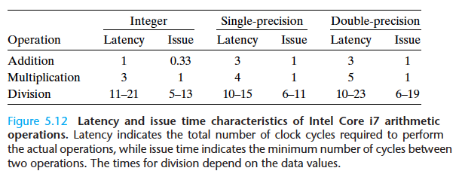
Pipelined Execution Within Functional Units
Capabilities of an Intel Core i7:
Notes:
The reason the Cycles/Issue is less than one (=0.33) is because there are three integer units.
“the latencies and issue times for division are given as ranges, because some combinations of dividend and divisor require more steps than others.” p. 501 of 2nd ed

Slide 43
Pipelined Execution
Code Example:
...
imull %eax, %ebx
immul %ecx, %edx
immul %edi, %esi
...
All 3 instructions can be pipelined in an integer multiply at different stages of execution
Instruction Control Unit (ICU)
Fetch
Control
Address
Retirement
Unit
Instruction
Cache
Register
File
Instruction
Decode
Instrs.
Operations
Register
Updates
Prediction
OK?
Execution Unit (EU)
Functional
Units
Integer/
Branch
General
Integer
FP
Add
FP
Mult/Div
Load
Store
Generally, can mix both parallel and pipelined execution inside CPU
Operation Results
Addr.
Addr.
Data
Data
Data
Cache

Slide 44
Instruction Control
Instruction Control
Fetch
Control
Address
Retirement
Unit
Instruction
Cache
Register
File
Instruction
Decode
Instrs.
Operations
Grabs Instruction Bytes From Memory
Based on current PC + predicted targets for predicted branches
Hardware dynamically guesses whether branches taken/not taken and (possibly) branch target
Translates Instructions Into Operations
Primitive steps required to perform instruction
Typical instruction requires 1–3 operations
Converts Register References Into Tags
Abstract identifier linking destination of one operation with sources of later operations

Slide 45
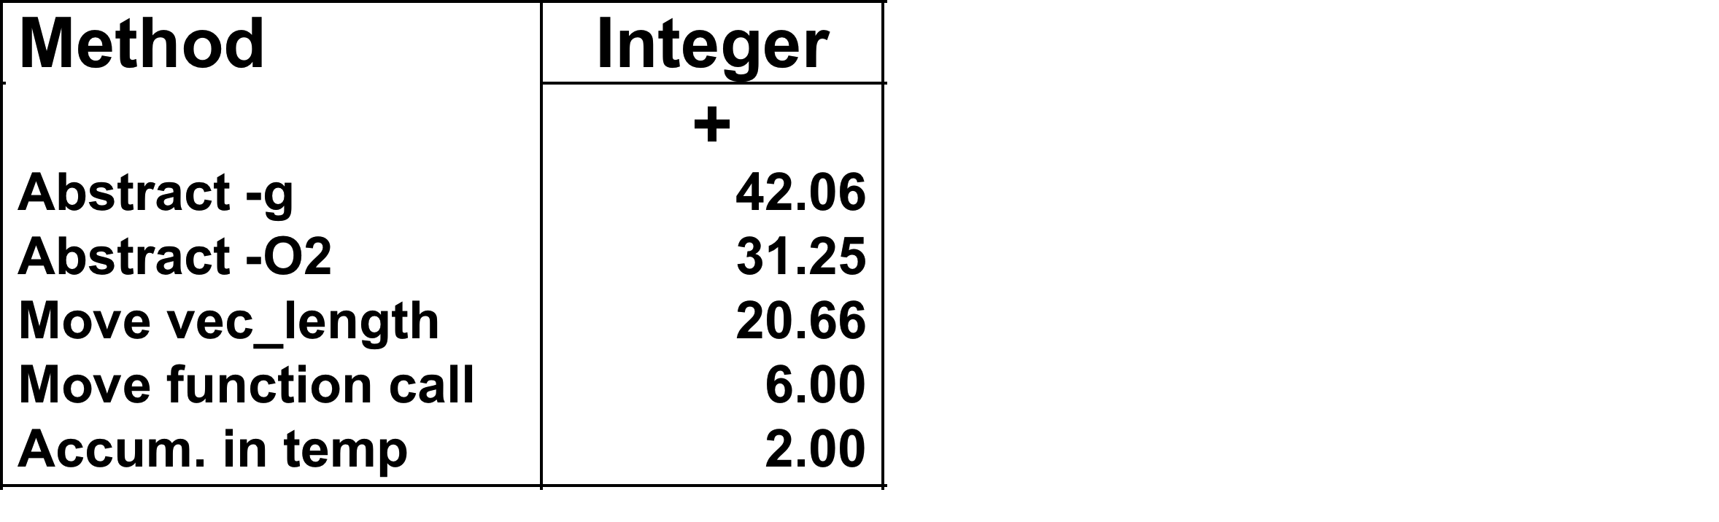
Previous Best Combining Code
combine1
combine2
combine3
combine4
void combine4(vec_ptr v, int *dest)
{
int i;
int length = vec_length(v);
int *data = get_vec_start(v);
int sum = 0;
for (i = 0; i < length; i++)
sum += data[i];
*dest = sum;
}

Slide 46
Translation Example
Version of Combine4
Integer data, add operation
.L24: # Loop:
addl (%eax,%edx,4),%ecx # sum += data[i]
incl %edx # i++
cmpl %esi,%edx # i:length
jl .L24 # if < goto Loop
Translation of First Iteration
.L24:
addl (%eax,%edx,4),%ecx
incl %edx
cmpl %esi,%edx
jl .L24
load (%eax,%edx.0,4) ➔ t.1
iaddl t.1, %ecx.0 ➔ %ecx.1
incl %edx.0 ➔ %edx.1
cmpl %esi, %edx.1 ➔ cc.1
jl-taken cc.1
ICU fetches add instruction & translates it to 2 operations for functional units, 1 for the load unit, 1 for an integer unit

Slide 47
Visualizing Operations
Operations
Note add depends on load completing first, but inc, cmp and jl are independent, so can execute in parallel!
We see register renaming inside the functional units, e.g. %edx.1 (see text)
Many instructions are spread over different functional units and are operating on different versions of registers
load (%eax,%edx.0,4) ➔ t.1
iaddl t.1, %ecx.0 ➔ %ecx.1
incl %edx.0 ➔ %edx.1
cmpl %esi, %edx.1 ➔ cc.1
jl-taken cc.1
%edx.0
load
load
incl
%edx.1
%ecx.i +1
cmpl
cc.1
%ecx.0
jl
Data-flow graph
load’s latency = 3 clock cycles, but can be pipelined
add’s latency = 1 clock cycle
Time
t.1
addl
%ecx.1

Slide 48
4 Iterations of Combining Sum
4 integer ops
Unlimited Resource Analysis, e.g. at least 4 loads & 4 integer units
Performance
Can begin a new iteration on each clock cycle
Should give CPE of 1.0
Would require executing 4 integer operations in parallel

Slide 49
Combining Sum: Resource Constraints
Only have two integer functional units
One pipelined load unit
Some operations delayed even though operands available
Set priority based on program order
Performance
Delay = 4-5 cycles, but CPE = 2.0

Slide 50
Translation Example
Version of Combine4
Integer data, multiply operation
Translation of First Iteration
.L24: # Loop:
imull (%eax,%edx,4),%ecx # t *= data[i]
incl %edx # i++
cmpl %esi,%edx # i:length
jl .L24 # if < goto Loop
.L24:
imull (%eax,%edx,4),%ecx
incl %edx
cmpl %esi,%edx
jl .L24
load (%eax,%edx.0,4) ➔ t.1
imull t.1, %ecx.0 ➔ %ecx.1
incl %edx.0 ➔ %edx.1
cmpl %esi, %edx.1 ➔ cc.1
jl-taken cc.1

Slide 51
Visualizing Operations
%edx.0
load (%eax,%edx,4) ➔ t.1
imull t.1, %ecx.0 ➔ %ecx.1
incl %edx.0 ➔ %edx.1
cmpl %esi, %edx.1 ➔ cc.1
jl-taken cc.1
load
incl
%edx.1
cmpl
cc.1
%ecx.0
jl
t.1
imull
Time
Operations
Vertical position denotes time at which executed
Cannot begin operation until operands available
Height denotes latency, so imull takes 4 clock cycles
Operands
Arcs shown only for operands that are passed within execution unit
%ecx.1

Slide 52
3 Iterations of Combining Product
Unlimited Resource Analysis
Performance
Can’t use imull pipeline due to data dependency
Limiting factor becomes latency of integer multiplier
Gives CPE of 4.0
Even with infinite # of integer units, cannot do better than this
Notes:
Even though the imull integer multiplier can be pipelined, we are unable to take advantage of the pipeline, because of the dependency of the data between iteration, i.e. for iteration i, %ecx.i+1 depends on the imull using %ecx.i to finish.

Slide 53
Loop Unrolling
void combine5(vec_ptr v, int *dest)
{
int length = vec_length(v);
int limit = length-2;
int *data = get_vec_start(v);
int sum = 0;
int i;
/* Combine 3 elements at a time */
for (i = 0; i < limit; i+=3) {
sum += data[i] + data[i+1]
+ data[i+2];
}
/* Finish any remaining elements */
for (; i < length; i++) {
sum += data[i];
}
*dest = sum;
}
Optimization
Combine multiple iterations into single loop body
Amortizes loop overhead across multiple iterations
Finish extras at end
Measured CPE = 1.33
This is a machine-dependent optimization

Slide 54
Visualizing Unrolled Loop
load (%eax,%edx.0,4) ➔ t.1a
iaddl t.1a, %ecx.0c ➔ %ecx.1a
load 4(%eax,%edx.0,4) ➔ t.1b
iaddl t.1b, %ecx.1a ➔ %ecx.1b
load 8(%eax,%edx.0,4) ➔ t.1c
iaddl t.1c, %ecx.1b ➔ %ecx.1c
iaddl $3,%edx.0 ➔ %edx.1
cmpl %esi, %edx.1 ➔ cc.1
jl-taken cc.1
Loads can pipeline, since don’t have dependencies
Only one set of loop control operations
%edx.0
load
addl
%edx.1
load
%ecx.i +1
cmpl
cc.1
load
jl
Time
%ecx.0c
t.1a
addl
%ecx.1a
t.1b
addl
%ecx.1b
t.1c
addl
%ecx.1c

Slide 55
Executing with Loop Unrolling
Predicted Performance
CPE = 1.0. One iteration in 3 cycles, and 3 elements per iteration
Loop unrolling allowed add/cmp/jl to be shifted in time so as not to conflict with the add after the load, (only 2 int units)
Measured Performance
CPE of 1.33, One iteration every 4 cycles
Notes:
The discrepancy between predicted and actual measured performance may be due to our model of the hardware being imperfect.

Slide 56
Effect of Unrolling
Unrolling Degree |  | 1 | 2 | 3 | 4 | 8 | 16
Integer | Sum | 2.00 | 1.50 | 1.33 | 1.50 | 1.25 | 1.06
Integer | Product | 4.00
FP | Sum | 3.00
FP | Product | 5.00
Only helps integer sum for our examples
Other cases constrained by functional unit latencies
Effect is nonlinear with degree of unrolling
Many subtle effects determine exact scheduling of operations

Slide 57
Visualizing Parallelism
data[i+2]
data[i+5]
data[i+8]
data[i+11]
data[i+14]
data[i+1]
data[i+4]
data[i+7]
data[i+10]
data[i+13]
data[i]
data[i+3]
data[i+6]
data[i+9]
data[i+12]
…
…
Loop unrolling with k=3
Loop unrolling with k=3, and
Parallel accumulators
combine5...{
...
for (i = 0; i < limit; i+=3) {
sum += data[i] + data[i+1]
+ data[i+2];
}
...
}
combine6...{
...
for (i = 0; i < limit; i+=3) {
acc0 = acc0 + data[i];
acc1 = acc1 + data[i+1];
acc2 = acc2 + data[i+2];
}
sum = acc0 + acc1 + acc2;
...
}

Slide 58
Visualizing Parallelism (2)
data[i+2]
data[i+5]
data[i+8]
data[i+11]
data[i+14]
data[i+1]
data[i+4]
data[i+7]
data[i+10]
data[i+13]
data[i]
data[i+3]
data[i+6]
data[i+9]
data[i+12]
…
…
acc0
Loop unrolling with k=3, and
Parallel accumulators
acc1
combine6...{
...
for (i = 0; i < limit; i+=3) {
acc0 = acc0 + data[i];
acc1 = acc1 + data[i+1];
acc2 = acc2 + data[i+2];
}
sum = acc0 + acc1 + acc2;
...
}
acc2
Each accumulator is independent of the other accumulators, so summing can occur in parallel
Sum together accumulators at the last step

Slide 59
Parallel Loop Unrolling
void combine6(vec_ptr v, int *dest)
{
int length = vec_length(v);
int limit = length-1;
int *data = get_vec_start(v);
int x0 = 1;
int x1 = 1;
int i;
/* Combine 2 elements at a time */
for (i = 0; i < limit; i+=2) {
x0 *= data[i];
x1 *= data[i+1];
}
/* Finish any remaining elements */
for (; i < length; i++) {
x0 *= data[i];
}
*dest = x0 * x1;
}
Code Version
Integer product
Optimization
Accumulate in two different products
Can be performed simultaneously
Combine at end
Performance
CPE = 2.0
2X performance

Slide 60
Serial Product Computation
1
x₀
*
x₁
*
x₂
int x=1; int i;
for (i = 0; i < limit; i++) {
x *= data[i];
}
*
x₃
*
x₄
*
x₅
Computation
((((((((((((1 * x₀) * x₁) * x₂) * x₃) * x₄) * x₅) * x₆) * x₇) * x₈) * x₉) * x₁₀) * x₁₁)
*
x₆
*
x₇
*
x₈
Performance
N elements, D cycles/operation
N*D cycles
*
x₉
*
x₁₀
*
x₁₁
*

Slide 61
Dual Parallel Product Computation
int x0 = 1; int x1 = 1; int i,x;
for (i = 0; i < limit; i+=2) {
x0 *= data[i];
x1 *= data[i+1];
}
...
x = x0 * x1;
1
x₀
1
x₁
*
x₂
*
x₃
Computation
((((((1 * x₀) * x₂) * x₄) * x₆) * x₈) * x₁₀)
*((((((1 * x₁) * x₃) * x₅) * x₇) * x₉) * x₁₁)
*
x₄
*
x₅
*
x₆
*
x₇
*
x₈
*
x₉
Performance
N elements, D cycles/operation
(N/2+1)*D cycles
~2X performance improvement
*
x₁₀
*
x₁₁
*
*
*

Slide 62
Visualizing Parallel Loop
load (%eax,%edx.0,4) ➔ t.1a
imull t.1a, %ecx.0 ➔ %ecx.1
load 4(%eax,%edx.0,4) ➔ t.1b
imull t.1b, %ebx.0 ➔ %ebx.1
iaddl $2,%edx.0 ➔ %edx.1
cmpl %esi, %edx.1 ➔ cc.1
jl-taken cc.1
...
for (i = 0; i < limit; i+=2) {
x0 *= data[i];
x1 *= data[i+1];
}
...
*dest = x0 * x1;
%edx.0
Two multiplies within loop no longer have data dependency
Allows them to pipeline (issue time of integer multiply is 1 clock cycle)
load
addl
%edx.1
load
cmpl
cc.1
%ecx.0
jl
t.1a
%ebx.0
imull
t.1b
imull
Time
%ecx.1
%ebx.1

Slide 63
Executing with Parallel Loop
Predicted Performance
Can keep 4-cycle multiplier busy performing two simultaneous multiplications
Gives CPE of 2.0
Notes:
The loads may be drawn incorrectly. They should be shifted down more at each iteration to allow pipelining of the one load unit. As drawn, this would suggest there are at least 3 load units, e.g. look at row 3. Also, as drawn, the add/cmp/jl execution stream suggest overlap of at leas three integer units. But the point of this slide is not to focus on the loads and add/cmp/jl, but on the pipelined overlap of the multipliers enabled by having independent multiply streams (in this case, of even and odd elements of the data array).

Slide 64
Requirements for Parallel Computation
Mathematical
Combining operation must be associative & commutative
OK for integer multiplication and addition
Not strictly true for floating point
We saw some pathological cases in the textbook where the order of floating point multiplication can cause overflow
e.g. in Ch 2, for single precision floating point, “(1e20*1e20)*1e-20 evaluates to +∞, while 1e20*(1e20*1e-20) evaluates to 1e20.”
OK for most applications
Hardware
Pipelined functional units
Ability to dynamically extract parallelism from code

Slide 65
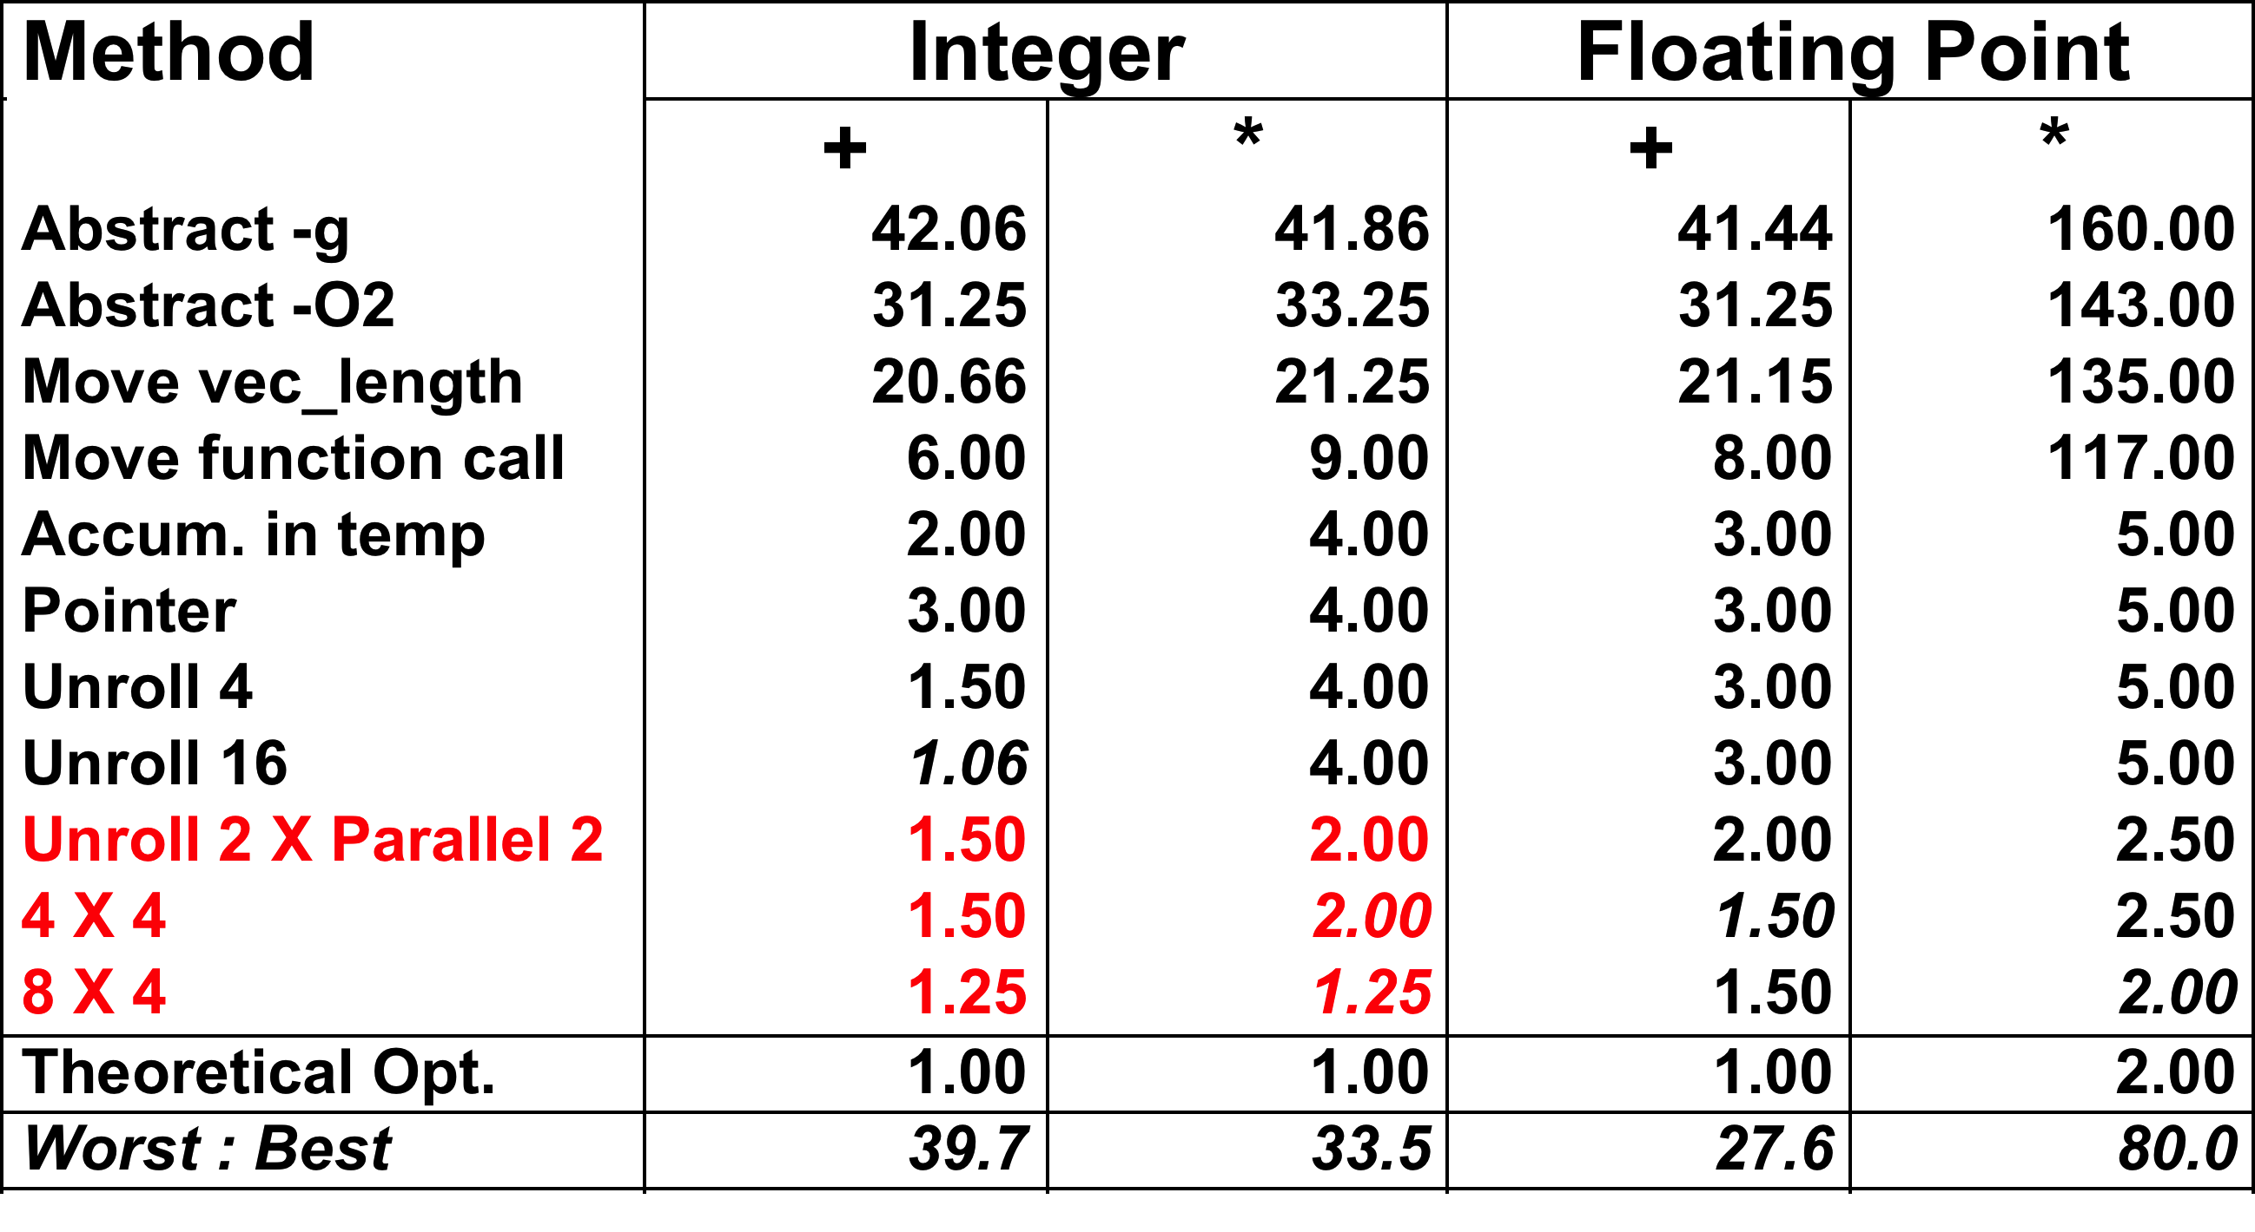
Optimization Results for Combining

Slide 66
Parallel Unrolling: Reassociation
void combine6aa(vec_ptr v, int *dest)
{
int length = vec_length(v);
int limit = length-1;
int *data = get_vec_start(v);
int x = 1;
int i;
/* Combine 2 elements at a time */
for (i = 0; i < limit; i+=2) {
x *= (data[i] * data[i+1]);
}
/* Finish any remaining elements */
for (; i < length; i++) {
x *= data[i];
}
*dest = x;
}
Code Version
Integer product
Optimization
Multiply pairs of elements together
And then update product
“Tree height reduction”
Performance
CPE = 2.5

Slide 67
Understanding Parallelism
/* Combine 2 elements at a time */
for (i = 0; i < limit; i+=2) {
x = (x * data[i]) * data[i+1];
}
CPE = 4.00
All multiplies performed in sequence and depend on the previous multiply
/* Combine 2 elements at a time */
for (i = 0; i < limit; i+=2) {
x = x * (data[i] * data[i+1]);
}
CPE = 2.50
Multiplies overlap: data[i]*data[i+1] independent of accumulator multiplies and next iteration multiply data[i+2]*data[i+3]

Slide 68
Reassociation (Method #2) Computation
Computation
((((((1 * (x₀ * x₁)) * (x₂ * x₃)) * (x₄ * x₅)) * (x₆ * x₇)) * (x₈ * x₉)) * (x₁₀ * x₁₁))
Performance
N elements, D cycles/operation
Should be (N/2+1)*D cycles
CPE = 2.0
Measured CPE worse
x₀
x₁
1
*
x₂
x₃
*
*
x₄
x₅
*
*
x₆
x₇
Unrolling | CPE (measured) | CPE (theoretical)
2 | 2.50 | 2.00
3 | 1.67 | 1.33
4 | 1.50 | 1.00
6 | 1.78 | 1.00
*
*
x₈
x₉
*
*
x₁₀
x₁₁
*
*
*

Slide 69
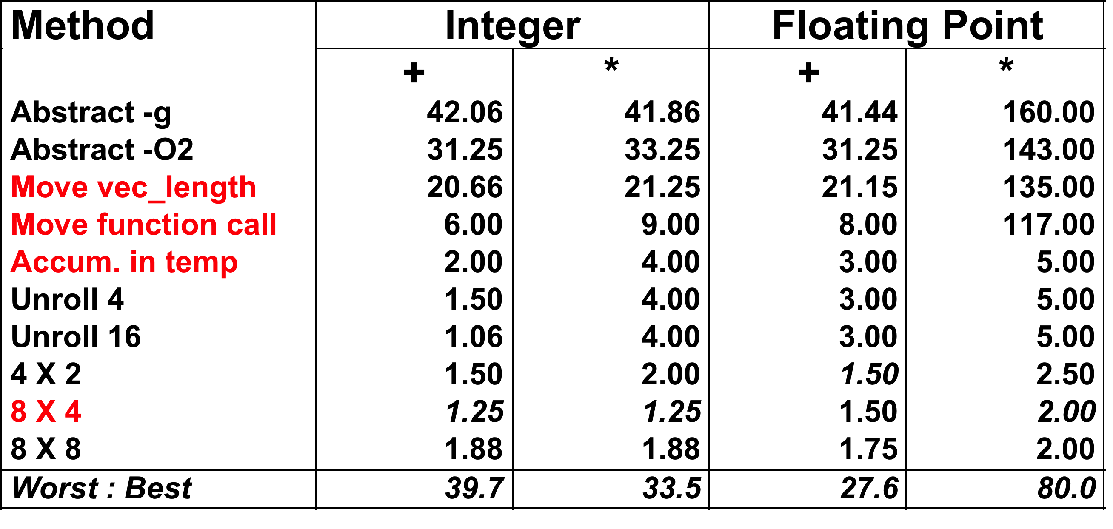
Summary: Results for Pentium III
Biggest gain doing basic optimizations
But, last little bit helps

Slide 70
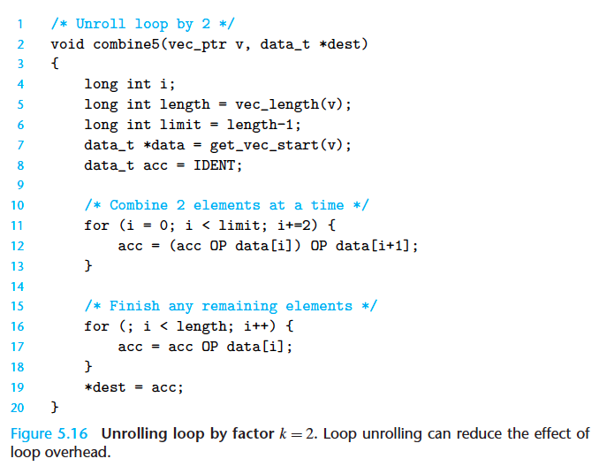
Figure 5.16 – Alternative Visualization

Slide 71
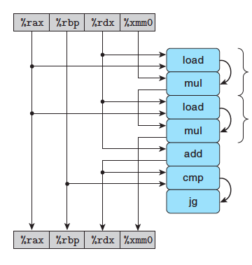
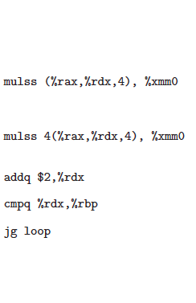
Figure 5.18 - Alternative Visualization
Notes:
This timing diagram is an alternative way to visualize the computation in each loop iteration, which helps identify bottlenecks/dependencies in the computations (see next slide).

Slide 72
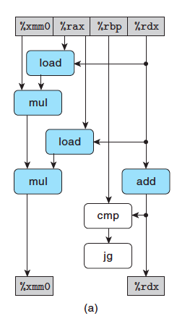
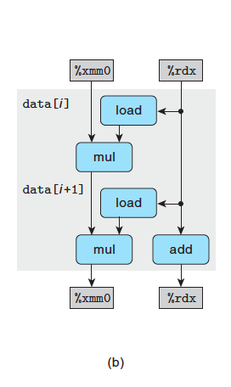
Figure 5.19 - Alternative Visualization

Slide 73
Limitations of Parallel Execution
We saw in the previous slide that parallelizing to 8x8 actually resulted in worse performance
Need Lots of Registers
e.g. to hold 8 parallel sums/products
Only 6 usable integer registers on 32-bit systems
Also needed for pointers, loop conditions
8 FP registers on 32-bit systems
When not enough registers, must spill temporaries onto stack
Wipes out any performance gains
Not helped by renaming
Cannot reference more operands than instruction set allows
Major drawback of IA32 instruction set

Slide 74
Register Spilling Example
.L165:
imull (%eax),%ecx
movl -4(%ebp),%edi
imull 4(%eax),%edi
movl %edi,-4(%ebp)
movl -8(%ebp),%edi
imull 8(%eax),%edi
movl %edi,-8(%ebp)
movl -12(%ebp),%edi
imull 12(%eax),%edi
movl %edi,-12(%ebp)
…
addl $32,%eax
addl $8,%edx
cmpl -32(%ebp),%edx
jl .L165
Example
8 X 8 integer product, so 8 parallel accumulators for partial products
7 local variables share 1 register
See that we are storing locals on stack
e.g., at -8(%ebp)
All this memory manipulation essentially negates any performance gain due to parallelism
Notes:
This is incomplete code, so it’s not clear why %ecx is at the top of the code.

Slide 75
What About Branches?
Challenge
Instruction Control Unit must work well ahead of Exec. Unit
To generate enough operations to keep EU busy
80489f3: movl $0x1,%ecx
80489f8: xorl %edx,%edx
80489fa: cmpl %esi,%edx
80489fc: jnl 8048a25
80489fe: movl %esi,%esi
8048a00: imull (%eax,%edx,4),%ecx
Executing
Fetching &
Decoding
When ICU encounters conditional branch, cannot reliably determine where to continue fetching
Notes:
Loops conditionally branch, so we’re speculatively executing way ahead. For example, the ICU could be multiple loop indices in advance, and if a branch is incorrect, then we have to wait to refill the pipeline.

Slide 76
Branch Outcomes
When encounter conditional branch, cannot determine where to continue fetching
Branch Taken: Transfer control to branch target
Branch Not-Taken: Continue with next instruction in sequence
Cannot resolve until outcome determined by branch/integer unit
80489f3: movl $0x1,%ecx
80489f8: xorl %edx,%edx
80489fa: cmpl %esi,%edx
80489fc: jnl 8048a25
80489fe: movl %esi,%esi
8048a00: imull (%eax,%edx,4),%ecx
Branch Not-Taken
Branch Taken
8048a25: cmpl %edi,%edx
8048a27: jl 8048a20
8048a29: movl 0xc(%ebp),%eax
8048a2c: leal 0xffffffe8(%ebp),%esp
8048a2f: movl %ecx,(%eax)

Slide 77
Branch Prediction
Idea
Guess which way branch will go
Begin executing instructions at predicted position
But don’t actually modify register or memory data
80489f3: movl $0x1,%ecx
80489f8: xorl %edx,%edx
80489fa: cmpl %esi,%edx
80489fc: jnl 8048a25
. . .
Predict Taken
8048a25: cmpl %edi,%edx
8048a27: jl 8048a20
8048a29: movl 0xc(%ebp),%eax
8048a2c: leal 0xffffffe8(%ebp),%esp
8048a2f: movl %ecx,(%eax)
Execute

Slide 78
Branch Prediction Through Loop
80488b1: movl (%ecx,%edx,4),%eax
80488b4: addl %eax,(%edi)
80488b6: incl %edx
80488b7: cmpl %esi,%edx
80488b9: jl 80488b1
Assume vector length = 100
i = 98
Predict Taken (OK)
80488b1: movl (%ecx,%edx,4),%eax
80488b4: addl %eax,(%edi)
80488b6: incl %edx
80488b7: cmpl %esi,%edx
80488b9: jl 80488b1
i = 99
Predict Taken
(Oops)
80488b1: movl (%ecx,%edx,4),%eax
80488b4: addl %eax,(%edi)
80488b6: incl %edx
80488b7: cmpl %esi,%edx
80488b9: jl 80488b1
Executed
Read invalid location
i = 100
Fetched
80488b1: movl (%ecx,%edx,4),%eax
80488b4: addl %eax,(%edi)
80488b6: incl %edx
80488b7: cmpl %esi,%edx
80488b9: jl 80488b1
i = 101

Slide 79
Branch Misprediction Invalidation
80488b1: movl (%ecx,%edx,4),%eax
80488b4: addl %eax,(%edi)
80488b6: incl %edx
80488b7: cmpl %esi,%edx
80488b9: jl 80488b1
Assume vector length = 100
i = 98
Predict Taken (OK)
80488b1: movl (%ecx,%edx,4),%eax
80488b4: addl %eax,(%edi)
80488b6: incl %edx
80488b7: cmpl %esi,%edx
80488b9: jl 80488b1
i = 99
Predict Taken (Oops)
80488b1: movl (%ecx,%edx,4),%eax
80488b4: addl %eax,(%edi)
80488b6: incl %edx
80488b7: cmpl %esi,%edx
80488b9: jl 80488b1
i = 100
Invalidate
80488b1: movl (%ecx,%edx,4),%eax
80488b4: addl %eax,(%edi)
80488b6: incl %edx
i = 101

Slide 80
Branch Misprediction Recovery
80488b1: movl (%ecx,%edx,4),%eax
80488b4: addl %eax,(%edi)
80488b6: incl %edx
80488b7: cmpl %esi,%edx
80488b9: jl 80488b1
Assume vector length = 100
i = 98
Predict Taken (OK)
80488b1: movl (%ecx,%edx,4),%eax
80488b4: addl %eax,(%edi)
80488b6: incl %edx
80488b7: cmpl %esi,%edx
80488b9: jl 80488b1
80488bb: leal 0xffffffe8(%ebp),%esp
80488be: popl %ebx
80488bf: popl %esi
80488c0: popl %edi
i = 99
Definitely not taken
Performance Cost
Misprediction on Pentium III wastes ~14 clock cycles
That’s a lot of time on a high performance processor

Slide 81
Avoiding Branches
On Modern Processor, Branches Very Expensive
Unless prediction can be reliable
When possible, best to avoid altogether
Example
Compute maximum of two values
14 cycles when prediction correct
29 cycles when incorrect
movl 12(%ebp),%edx # Get y
movl 8(%ebp),%eax # rval=x
cmpl %edx,%eax # rval:y
jge L11 # skip when >=
movl %edx,%eax # rval=y
L11:
int max(int x, int y)
{
return (x < y) ? y : x;
}

Slide 82
Conditional Move
Added with P6 microarchitecture (PentiumPro onward)
cmovXXl %edx, %eax
If condition XX holds, copy %edx to %eax
Doesn’t involve any branching – much more predictable
Handled as operation within Execution Unit
movl 8(%ebp),%edx # Get x
movl 12(%ebp),%eax # rval=y
cmpl %edx, %eax # rval:x
cmovll %edx,%eax # If <, rval=x
Current version of GCC won’t use this instruction
Thinks it’s compiling for a 386
Can turn on use of conditional move by gcc by compiling with optimization flags -O1, -O2, -O3, …
Performance
14 cycles on all data
Notes:
For gcc flags and cmov, see for example https://gcc.gnu.org/onlinedocs/gcc/Optimize-Options.html

Slide 83
Conditional Move
Writing code that is conditional-move-friendly
For gcc, use conditional operations to compute outcome(s)
Then assign the result variable(s)
Example:
1 /* Rearrange two vectors so that for each i, b[i] >= a[i] */
2 void minmax2(int a[], int b[], int n) {
3 int i;
4 for (i = 0; i < n; i++) {
5 int min = a[i] < b[i] ? a[i] : b[i];
6 int max = a[i] < b[i] ? b[i] : a[i];
7 a[i] = min;
8 b[i] = max;
9 }
10}

Slide 84
Limitations on Optimization
# Functional units of each type
Don’t have unlimited resources
How deeply each operation can be pipelined
# registers => Register spilling
If you over-parallelize, there are not enough data registers to hold all the accumulators, so they have to be stored in memory
Branch prediction
must refill pipeline after a misprediction
Data dependencies in your graph
a) slow down pipeline
b) memory dependencies (next)
Amdahl’s Law (next)
Notes:
Can also be limited the # functional units, and how deeply pipelined each functional unit can be.

Slide 85
Memory Load/Store Bottlenecks (5.12)
x86 supports one Load unit and one Store unit to interact with memory
Load and Store functional units can initiate one load or store each clock cycle
Latency is 3-4 clock cycles, so can pipeline 3-4 load or store instructions on each unit
Usually, can pipeline loads and stores, except
A load can depend on a previous load, e.g. ls = ls->next
i.e. the second load cannot begin until the first load has finished
Loads can depend on previous stores to the same memory address, forming a write/read dependency
i.e. if you write then read from the same memory location, must wait for write to complete before reading
Notes:
Just as a data dependency on combine4 products (can’t do next multiply until previous multiply completes, because the next multiply depends on/needs the input from the results of the previous multiply) prevented us from taking advantage of pipelining multiplies, a similar data dependency prevents pipelining loads/stores.

Slide 86
A Load Can Depend on a Prior Load
Example (64 bit):
# len in %eax, ls in %rdi
.L11: # loop:
addl $1, %eax # Increment len
movq (%rdi), %rdi # ls = ls->next
testq %rdi, %rdi # Test ls
jne .L11 # If nonnull, goto loop
Notes:
The movq can be broken down into a load (%rdi) and a movq “load_result”, %rdi. As we iterate the loop, we execute the next load. But it cannot begin until the prior load has completed and updated %rdi.

Slide 87
A Load Can Depend on a Prior Store
Example:
# what if %ecx = %ebx?
movl %eax,(%ecx) # Store
movl (%ebx),%eax # Load
addl $1,%eax
subl $1,%edx
jne loop
# if %ecx = %ebx, then you’re reading from the same memory location that was just written – the read must wait for the write to complete
CPU creates a store buffer of addresses of stores. A load must check the store buffer to see if there is a dependency before loading

Slide 88
(Chapter 5) Amdahl’s Law – Know Your Limits!
The speedup in your program via parallelization is fundamentally limited by the slowest sequential portion of your program
T = time to execute a program
P = % of program that can be sped up a factor S times
T
New time T’ = P* + (1-P)*T
S
Total speedup = T/T’ =
As S-> ∞, T/T’ ->
1
1
1-P +
P
1-P
S
Ex. P=70%, S=100, Total speedup = 1/(.3 +.007) = 3.25!

Slide 89
Machine-Dependent Opt. Summary
Loop Unrolling
Some compilers do this automatically
Generally not as clever as what can achieve by hand
Exposing Instruction-Level Parallelism
Very machine dependent
Warning:
Benefits depend heavily on particular machine
Best if performed by compiler
But GCC on IA32/Linux is not very good
Do only for performance-critical parts of code

Slide 90
Chapter 5: Optimization Limits, Code Profiling
Topics:
Limits on Optimization
Code Profiling
Identifying performance bottlenecks

Slide 91
Important Profiling Tools
Find the bottleneck…
Measurement
Accurately compute time taken by code
Most modern machines have built in cycle counters
Using them to get reliable measurements is tricky
Profile procedure calling frequencies
Unix tool gprof
Analyze memory performance, e.g. leaks
valgrind
Observation
Generating assembly code
Lets you see what optimizations compiler can make
Understand capabilities/limitations of particular compiler

Slide 92
Code Profiling Example
Task
Count word frequencies in text document
Produce sorted list of words from most frequent to least
Steps
Convert strings to lowercase
Apply hash function
Each hash bucket is a linked list.
Search list,
If not found, insert in list
If found, increment counter for word
Sort results
Data Set
Collected works of Shakespeare
946,596 total words, 26,596 unique
Initial implementation: 9.2 seconds
Shakespeare’s
most frequent words
29,801 | the
27,529 | and
21,029 | I
20,957 | to
18,514 | of
15,370 | a
14010 | you
12,936 | my
11,722 | in
11,519 | that
Notes:
Could also count pairs of words, this is a 2-gram. Can count occurrences of a sequence of N words (N-grams) as well.

Slide 93
Hash Function
Takes a set of input values and maps/groups them into N subsets or buckets
Typically used to quickly classify/separate inputs into one of N possible categories
Example 1: if set of input values = all English words, then h(word) could classify a word by its first letter, creating 26 buckets, e.g. bucket ‘a’ contains all words starting with ‘a’…
Example 2: if set of input values = all integers, then h(num) = num mod 4 would classify the input into one of 4 buckets
N buckets:
Note the length of each
bucket denotes the #
of items hashed to that
bucket. For some but not
all hashes, a desired
property is that the hash
uniformly distributes the
input values to the buckets
Hash h(input)

Slide 94
Code Profiling Example (cont.)
Task
Count word frequencies in text document
Produce sorted list of words from most frequent to least
Shakespeare
words
you
to
count=1007
count=86
Convert strings to lowercase
hash
and
sort
count=4227
my
the
of
count=33
count=3105
count=1
Let hash = sum of letters in a word
Sorted
list

Slide 95
Code Profiling
Augment Executable Program with Timing Functions
Computes (approximate) amount of time spent in each function
Time computation method
Periodically (~ every 10ms) interrupt program
Determine what function is currently executing
Increment its timer by interval (e.g., 10ms)
Also maintains counter for each function indicating number of times called
Using
gcc –O2 –pg prog.c –o prog
./prog
Executes in normal fashion, but also generates file gmon.out
gprof prog
Generates profile information based on gmon.out

Slide 96
Profiling Results
% cumulative self self total
time seconds seconds calls ms/call ms/call name
86.60 8.21 8.21 1 8210.00 8210.00 sort_words
5.80 8.76 0.55 946596 0.00 0.00 lower1
4.75 9.21 0.45 946596 0.00 0.00 find_ele_rec
1.27 9.33 0.12 946596 0.00 0.00 h_add
Call Statistics
Number of calls and cumulative time for each function
Performance Limiter
Using inefficient sorting algorithm
Single call uses 87% of CPU time
Notes:
The “cumulative seconds” field represents the total in this function *and* all of the functions above it in the table.
The “self seconds” field represents just the time in this function.

Slide 97
Code Optimizations
First step: Use more efficient sorting function
Library function qsort
Notes:
Note: the Sort time has all but disappeared. The textbook has a similar result: the Quicksort causes the sorting time to become less than 1% of the initial time.
Quicksort usually has O(n*log n) complexity.

Slide 98
Further Optimizations
Iter first: Use iterative function to insert elements into linked list
Causes code to slow down
Iter last: Iterative function, places new entry at end of list
Tend to place most common words at front of list
Big table: Increase number of hash buckets
Better hash: spreads hash results more uniformly across buckets, thus reducing length of linked lists
Linear lower: Move strlen out of loop
Notes:
Note:

Slide 99
Profiling Observations
Benefits
Helps identify performance bottlenecks
Especially useful when have complex system with many components
Limitations
Only shows performance for data tested
Timing mechanism fairly crude
Only works for programs that run for > 3 seconds
e.g., linear lower did not show big gain, since words are short
Quadratic inefficiency could remain lurking in code, i.e. it could be revealed when input data is mostly longer word strings

Slide 100
Role of Programmer
How should I write my programs, given that I have a good, optimizing compiler?
Don’t: Completely Sacrifice Modularity for Performance
Hard to read, maintain, & assure correctness
Do: Balance Modularity and Performance
Write code that’s readable & maintainable
Procedures, recursion, without built-in constant limits
Even though these factors can slow down code
Use profilers to identify bottlenecks
Select best algorithm, e.g. best sorting algorithm
Eliminate optimization blockers
Allows compiler to do its job. And use optimization flags -O1, -O2,…
Focus on Inner Loops
Do detailed optimizations where code will be executed repeatedly
Will get most performance gain here

Slide 101
Supplementary Slides

Slide 102
Compiler-Generated Code Motion (-O1)
void set_row(double *a, double *b,
long i, long n)
{
long j;
for (j = 0; j < n; j++)
a[n*i+j] = b[j];
}
long j;
long ni = n*i;
double *rowp = a+ni;
for (j = 0; j < n; j++)
*rowp++ = b[j];
set_row:
testq %rcx, %rcx # Test n
jle .L1 # If 0, goto done
imulq %rcx, %rdx # ni = n*i
leaq (%rdi,%rdx,8), %rdx # rowp = A + ni*8
movl $0, %eax # j = 0
.L3: # loop:
movsd (%rsi,%rax,8), %xmm0 # t = b[j]
movsd %xmm0, (%rdx,%rax,8) # M[A+ni*8 + j*8] = t
addq $1, %rax # j++
cmpq %rcx, %rax # j:n
jne .L3 # if !=, goto loop
.L1: # done:
rep ; ret

Slide 103
Calling Strlen
/* My version of strlen */
size_t strlen(const char *s)
{
size_t length = 0;
while (*s != '\0') {
s++;
length++;
}
return length;
}
Strlen performance
Only way to determine length of string is to scan its entire length, looking for null character.
Overall performance, string of length N
N calls to strlen
Require times N, N-1, N-2, …, 1
Overall O(N²) performance

Slide 104
Memory Matters
/* Sum rows is of n X n matrix a
and store in vector b */
void sum_rows1(double *a, double *b, long n) {
long i, j;
for (i = 0; i < n; i++) {
b[i] = 0;
for (j = 0; j < n; j++)
b[i] += a[i*n + j];
}
}
# sum_rows1 inner loop
.L4:
movsd (%rsi,%rax,8), %xmm0 # FP load
addsd (%rdi), %xmm0 # FP add
movsd %xmm0, (%rsi,%rax,8) # FP store
addq $8, %rdi
cmpq %rcx, %rdi
jne .L4
Code updates b[i] on every iteration
Why couldn’t compiler optimize this away?

Slide 105
Memory Aliasing
/* Sum rows is of n X n matrix a
and store in vector b */
void sum_rows1(double *a, double *b, long n) {
long i, j;
for (i = 0; i < n; i++) {
b[i] = 0;
for (j = 0; j < n; j++)
b[i] += a[i*n + j];
}
}
Value of B:
double A[9] =
{ 0, 1, 2,
4, 8, 16,
32, 64, 128};
double B[3] = A+3;
sum_rows1(A, B, 3);
init: [4, 8, 16]
i = 0: [3, 8, 16]
i = 1: [3, 22, 16]
i = 2: [3, 22, 224]
Code updates b[i] on every iteration
Must consider possibility that these updates will affect program behavior

Slide 106
Removing Aliasing
/* Sum rows is of n X n matrix a
and store in vector b */
void sum_rows2(double *a, double *b, long n) {
long i, j;
for (i = 0; i < n; i++) {
double val = 0;
for (j = 0; j < n; j++)
val += a[i*n + j];
b[i] = val;
}
}
# sum_rows2 inner loop
.L10:
addsd (%rdi), %xmm0 # FP load + add
addq $8, %rdi
cmpq %rax, %rdi
jne .L10
No need to store intermediate results

Slide 107
Optimization Blocker: Memory Aliasing
Aliasing
Two different memory references specify single location
Easy to have happen in C
Since allowed to do address arithmetic
Direct access to storage structures
Get in habit of introducing local variables
Accumulating within loops
Your way of telling compiler not to check for aliasing

Slide 108
Exploiting Instruction-Level Parallelism
Need general understanding of modern processor design
Hardware can execute multiple instructions in parallel
Performance limited by data dependencies
Simple transformations can yield dramatic performance improvement
Compilers often cannot make these transformations
Lack of associativity and distributivity in floating-point arithmetic

Slide 109
Benchmark Computation
void combine1(vec_ptr v, data_t *dest)
{
long int i;
*dest = IDENT;
for (i = 0; i < vec_length(v); i++) {
data_t val;
get_vec_element(v, i, &val);
*dest = *dest OP val;
}
}
Compute sum or product of vector elements
Data Types
Use different declarations for data_t
int
long
float
double
Operations
Use different definitions of OP and IDENT
+ / 0
* / 1

Slide 110
Benchmark Example: Data Type for Vectors
/* data structure for vectors */
typedef struct{
size_t len;
data_t *data;
} vec;
len
0
1
len-1
data
Data Types
Use different declarations for data_t
int
long
float
double
/* retrieve vector element
and store at val */
int get_vec_element
(*vec v, size_t idx, data_t *val)
{
if (idx >= v->len)
return 0;
*val = v->data[idx];
return 1;
}

Slide 111
Cycles Per Element (CPE)
Convenient way to express performance of program that operates on vectors or lists
Length = n
In our case: CPE = cycles per OP
T = CPE*n + Overhead
CPE is slope of line
psum1
Slope = 9.0
psum2
Slope = 6.0

Slide 112
Benchmark Performance
void combine1(vec_ptr v, data_t *dest)
{
long int i;
*dest = IDENT;
for (i = 0; i < vec_length(v); i++) {
data_t val;
get_vec_element(v, i, &val);
*dest = *dest OP val;
}
}
Compute sum or product of vector elements
Method | Integer |  | Double FP
Operation | Add | Mult | Add | Mult
Combine1 unoptimized | 22.68 | 20.02 | 19.98 | 20.18
Combine1 –O1 | 10.12 | 10.12 | 10.17 | 11.14

Slide 113
Basic Optimizations
void combine4(vec_ptr v, data_t *dest)
{
long i;
long length = vec_length(v);
data_t *d = get_vec_start(v);
data_t t = IDENT;
for (i = 0; i < length; i++)
t = t OP d[i];
*dest = t;
}
Move vec_length out of loop
Avoid bounds check on each cycle
Accumulate in temporary

Slide 114
Effect of Basic Optimizations
void combine4(vec_ptr v, data_t *dest)
{
long i;
long length = vec_length(v);
data_t *d = get_vec_start(v);
data_t t = IDENT;
for (i = 0; i < length; i++)
t = t OP d[i];
*dest = t;
}
Method | Integer |  | Double FP
Operation | Add | Mult | Add | Mult
Combine1 –O1 | 10.12 | 10.12 | 10.17 | 11.14
Combine4 | 1.27 | 3.01 | 3.01 | 5.01
Eliminates sources of overhead in loop

Slide 115
Modern CPU Design
Instruction Control
Fetch
Control
Address
Instruction
Cache
Retirement
Unit
Register
File
Instruction
Decode
Instructions
Operations
Register Updates
Prediction OK?
Execution
Functional
Units
Branch
Arith
Arith
Arith
Load
Store
Operation Results
Addr.
Addr.
Data
Data
Data
Cache

Slide 116
Superscalar Processor
Definition: A superscalar processor can issue and execute multiple instructions in one cycle. The instructions are retrieved from a sequential instruction stream and are usually scheduled dynamically.
Benefit: without programming effort, superscalar processor can take advantage of the instruction level parallelism that most programs have
Most modern CPUs are superscalar.
Intel: since Pentium (1993)

Slide 117
Pipelined Functional Units
Stage 1
long mult_eg(long a, long b, long c) {
long p1 = a*b; long p2 = a*c; long p3 = p1 * p2;
return p3; }
Stage 2
Stage 3
 | Time
 | 1 | 2 | 3 | 4 | 5 | 6 | 7
Stage 1 | a*b | a*c |  |  | p1*p2
Stage 2 |  | a*b | a*c |  |  | p1*p2
Stage 3 |  |  | a*b | a*c |  |  | p1*p2
Divide computation into stages
Pass partial computations from stage to stage
Stage i can start on new computation once values passed to i+1
E.g., complete 3 multiplications in 7 cycles, even though each requires 3 cycles

Slide 118
Haswell CPU
8 Total Functional Units
Multiple instructions can execute in parallel
2 load, with address computation
1 store, with address computation
4 integer
2 FP multiply
1 FP add
1 FP divide
Some instructions take > 1 cycle, but can be pipelined
Instruction Latency Cycles/Issue
Load / Store 4 1
Integer Multiply 3 1
Integer/Long Divide 3-30 3-30
Single/Double FP Multiply 5 1
Single/Double FP Add 3 1
Single/Double FP Divide 3-15 3-15

Slide 119
x86-64 Compilation of Combine4
Inner Loop (Case: Integer Multiply)
.L519: # Loop:
imull (%rax,%rdx,4), %ecx # t = t * d[i]
addq $1, %rdx # i++
cmpq %rdx, %rbp # Compare length:i
jg .L519 # If >, goto Loop
Method | Integer |  | Double FP
Operation | Add | Mult | Add | Mult
Combine4 | 1.27 | 3.01 | 3.01 | 5.01
Latency Bound | 1.00 | 3.00 | 3.00 | 5.00

Slide 120
Combine4 = Serial Computation (OP = *)
Computation (length=8)
((((((((1 * d[0]) * d[1]) * d[2]) * d[3]) * d[4]) * d[5]) * d[6]) * d[7])
Sequential dependence
Performance: determined by latency of OP
1
d₀
*
d₁
*
d₂
*
d₃
*
d₄
*
d₅
*
d₆
*
d₇
*

Slide 121
Loop Unrolling (2x1)
void unroll2a_combine(vec_ptr v, data_t *dest)
{
long length = vec_length(v);
long limit = length-1;
data_t *d = get_vec_start(v);
data_t x = IDENT;
long i;
/* Combine 2 elements at a time */
for (i = 0; i < limit; i+=2) {
x = (x OP d[i]) OP d[i+1];
}
/* Finish any remaining elements */
for (; i < length; i++) {
x = x OP d[i];
}
*dest = x;
}
Perform 2x more useful work per iteration

Slide 122
Effect of Loop Unrolling
Method | Integer |  | Double FP
Operation | Add | Mult | Add | Mult
Combine4 | 1.27 | 3.01 | 3.01 | 5.01
Unroll 2x1 | 1.01 | 3.01 | 3.01 | 5.01
Latency Bound | 1.00 | 3.00 | 3.00 | 5.00
Helps integer add
Achieves latency bound
Others don’t improve. Why?
Still sequential dependency
x = (x OP d[i]) OP d[i+1];

Slide 123
Loop Unrolling with Reassociation (2x1a)
void unroll2aa_combine(vec_ptr v, data_t *dest)
{
long length = vec_length(v);
long limit = length-1;
data_t *d = get_vec_start(v);
data_t x = IDENT;
long i;
/* Combine 2 elements at a time */
for (i = 0; i < limit; i+=2) {
x = x OP (d[i] OP d[i+1]);
}
/* Finish any remaining elements */
for (; i < length; i++) {
x = x OP d[i];
}
*dest = x;
}
Compare to before
x = (x OP d[i]) OP d[i+1];
Can this change the result of the computation?
Yes, for FP. Why?

Slide 124
Effect of Reassociation
Method | Integer |  | Double FP
Operation | Add | Mult | Add | Mult
Combine4 | 1.27 | 3.01 | 3.01 | 5.01
Unroll 2x1 | 1.01 | 3.01 | 3.01 | 5.01
Unroll 2x1a | 1.01 | 1.51 | 1.51 | 2.51
Latency Bound | 1.00 | 3.00 | 3.00 | 5.00
Throughput Bound | 0.50 | 1.00 | 1.00 | 0.50
Nearly 2x speedup for Int *, FP +, FP *
Reason: Breaks sequential dependency
Why is that? (next slide)
2 func. units for FP *
2 func. units for load
x = x OP (d[i] OP d[i+1]);
4 func. units for int +
2 func. units for load

Slide 125
Reassociated Computation
x = x OP (d[i] OP d[i+1]);
What changed:
Ops in the next iteration can be started early (no dependency)
Overall Performance
N elements, D cycles latency/op
(N/2+1)*D cycles: CPE = D/2
d₀
d₁
*
d₂
d₃
1
*
d₄
d₅
*
*
d₆
d₇
*
*
*
*

Slide 126
Loop Unrolling with Separate Accumulators (2x2)
void unroll2a_combine(vec_ptr v, data_t *dest)
{
long length = vec_length(v);
long limit = length-1;
data_t *d = get_vec_start(v);
data_t x0 = IDENT;
data_t x1 = IDENT;
long i;
/* Combine 2 elements at a time */
for (i = 0; i < limit; i+=2) {
x0 = x0 OP d[i];
x1 = x1 OP d[i+1];
}
/* Finish any remaining elements */
for (; i < length; i++) {
x0 = x0 OP d[i];
}
*dest = x0 OP x1;
}
Different form of reassociation

Slide 127
Effect of Separate Accumulators
Method | Integer |  | Double FP
Operation | Add | Mult | Add | Mult
Combine4 | 1.27 | 3.01 | 3.01 | 5.01
Unroll 2x1 | 1.01 | 3.01 | 3.01 | 5.01
Unroll 2x1a | 1.01 | 1.51 | 1.51 | 2.51
Unroll 2x2 | 0.81 | 1.51 | 1.51 | 2.51
Latency Bound | 1.00 | 3.00 | 3.00 | 5.00
Throughput Bound | 0.50 | 1.00 | 1.00 | 0.50
Int + makes use of two load units
2x speedup (over unroll2) for Int *, FP +, FP *
x0 = x0 OP d[i];
x1 = x1 OP d[i+1];

Slide 128
Separate Accumulators
x0 = x0 OP d[i];
x1 = x1 OP d[i+1];
What changed:
Two independent “streams” of operations
Overall Performance
N elements, D cycles latency/op
Should be (N/2+1)*D cycles: CPE = D/2
CPE matches prediction!
1
d₀
1
d₁
*
d₂
*
d₃
*
d₄
*
d₅
*
d₆
*
d₇
*
*
What Now?
*

Slide 129
Unrolling & Accumulating
Idea
Can unroll to any degree L
Can accumulate K results in parallel
L must be multiple of K
Limitations
Diminishing returns
Cannot go beyond throughput limitations of execution units
Large overhead for short lengths
Finish off iterations sequentially

Slide 130
Unrolling & Accumulating: Double *
Case
Intel Haswell
Double FP Multiplication
Latency bound: 5.00. Throughput bound: 0.50
FP * | Unrolling Factor L
K | 1 | 2 | 3 | 4 | 6 | 8 | 10 | 12
1 | 5.01 | 5.01 | 5.01 | 5.01 | 5.01 | 5.01 | 5.01
2 |  | 2.51 |  | 2.51 |  | 2.51
3 |  |  | 1.67
4 |  |  |  | 1.25 |  | 1.26
6 |  |  |  |  | 0.84 |  |  | 0.88
8 |  |  |  |  |  | 0.63
10 |  |  |  |  |  |  | 0.51
12 |  |  |  |  |  |  |  | 0.52
Accumulators

Slide 131
Unrolling & Accumulating: Int +
Case
Intel Haswell
Integer addition
Latency bound: 1.00. Throughput bound: 1.00
FP * | Unrolling Factor L
K | 1 | 2 | 3 | 4 | 6 | 8 | 10 | 12
1 | 1.27 | 1.01 | 1.01 | 1.01 | 1.01 | 1.01 | 1.01
2 |  | 0.81 |  | 0.69 |  | 0.54
3 |  |  | 0.74
4 |  |  |  | 0.69 |  | 1.24
6 |  |  |  |  | 0.56 |  |  | 0.56
8 |  |  |  |  |  | 0.54
10 |  |  |  |  |  |  | 0.54
12 |  |  |  |  |  |  |  | 0.56
Accumulators

Slide 132
Achievable Performance
Method | Integer |  | Double FP
Operation | Add | Mult | Add | Mult
Best | 0.54 | 1.01 | 1.01 | 0.52
Latency Bound | 1.00 | 3.00 | 3.00 | 5.00
Throughput Bound | 0.50 | 1.00 | 1.00 | 0.50
Limited only by throughput of functional units
Up to 42X improvement over original, unoptimized code

Slide 133
Getting High Performance
Good compiler and flags
Watch out for hidden algorithmic inefficiencies
Write compiler-friendly code
Watch out for optimization blockers: procedure calls & memory references
Look carefully at innermost loops (where most work is done)

Slide 134
Time Scales
Absolute Time
Typically use nanoseconds
10^{–9} seconds
Time scale of computer instructions
Clock Cycles
Most computers controlled by high frequency clock signal
Typical Range
100 MHz
10⁸ cycles per second
Clock period = 10ns
2 GHz
2 X 10⁹ cycles per second
Clock period = 0.5ns

Slide 135
Lower Case Conversion Performance
Time doubles when double string length
Linear performance

Slide 136
Recap…
combine4
combine3
combine2
Machine-independent optimizations
void combine1(vec_ptr v, int *dest)
{
int i;
*dest = 0;
for (i = 0; i < vec_length(v); i++) {
int val;
get_vec_element(v, i, &val);
*dest += val;
}
}
Improving software performance
How does combine4 achieves a CPE of 2 ?
Need low level assembly
How is it mapped to 2 x86 integer functional units?
void combine4(vec_ptr v,
int *dest)
{
int i;
int length = vec_length(v);
int *data = get_vec_start(v);
int sum = 0;
for (i = 0; i < length; i++)
sum += data[i];
*dest = sum;
}
load (%eax,%edx.0,4) ➔ t.1
iaddl t.1, %ecx.0 ➔ %ecx.1
incl %edx.0 ➔ %edx.1
cmpl %esi, %edx.1 ➔ cc.1
jl-taken cc.1

Slide 137
Combine4 Sum over 2 Integer Units
%edx.0
load
load
incl
%edx.1
%ecx.i +1
cmpl
cc.1
%ecx.0
jl
Time
t.1
addl
%ecx.1
Performance
Delay = 4-5 cycles, but CPE = 2.0

Slide 138
Recap…
Improving software performance
Can we achieve a CPE below 2?
combine5 unrolls loop and gets CPE ≈ 1, machine-dependent
combine5...{
...
for (i = 0; i < limit; i+=3) {
sum += data[i] + data[i+1]
+ data[i+2];
}
...
}

Slide 139
Recap…
Loop unrolling with k=3, and
Parallel accumulators
combine6 uses *both* loop unrolling *and* parallel independent accumulators
combine6...{
...
for (i = 0; i < limit; i+=3) {
acc0 = acc0 + data[i];
acc1 = acc1 + data[i+1];
acc2 = acc2 + data[i+2];
}
sum = acc0 + acc1 + acc2;
...
}
Doesn’t help much for addition, but it does help a lot for multiplication
Before Optimization, CPE = 4
%edx.0
Before Optimization:
load
incl
%edx.1
...
for (i = 0; i < limit; i++) {
x *= data[i];
}
...
*dest = x;
cmpl
cc.1
%ecx.0
jl
t.1
Time
imull
%ecx.1

Slide 140
Loop Unrolling + Parallel Products
Can keep 4-cycle multiplier busy by pipelining two multiplications
After optimization: CPE = 2.0 !
...
for (i = 0; i < limit; i+=2) {
x0 *= data[i];
x1 *= data[i+1];
}
...
*dest = x0 * x1;

Slide 141
Great Reality #4
There’s more to performance than asymptotic complexity
Constant factors matter too!
Easily see 10:1 performance range depending on how code is written
Must optimize at multiple levels:
algorithm, data representations, procedures, and loops
Must understand system to optimize performance
How programs are compiled and executed
How to measure program performance and identify bottlenecks
How to improve performance without destroying code modularity and generality

Slide 142
Translation Example
Version of Combine4
Integer data, multiply operation
Translation of First Iteration
.L24: # Loop:
imull (%eax,%edx,4),%ecx # t *= data[i]
incl %edx # i++
cmpl %esi,%edx # i:length
jl .L24 # if < goto Loop
.L24:
imull (%eax,%edx,4),%ecx
incl %edx
cmpl %esi,%edx
jl .L24
load (%eax,%edx.0,4) ➔ t.1
imull t.1, %ecx.0 ➔ %ecx.1
incl %edx.0 ➔ %edx.1
cmpl %esi, %edx.1 ➔ cc.1
jl-taken cc.1

Slide 143
Translation Example #1
imull (%eax,%edx,4),%ecx
load (%eax,%edx.0,4) ➔ t.1
imull t.1, %ecx.0 ➔ %ecx.1
Split into two operations
load reads from memory to generate temporary result t.1
Multiply operation just operates on registers
Operands
Registers %eax does not change in loop. Values will be retrieved from register file during decoding
Register %ecx changes on every iteration. Uniquely identify different versions as %ecx.0, %ecx.1, %ecx.2, …
Register renaming
Values passed directly from producer to consumers

Slide 144
Translation Example #2
incl %edx
incl %edx.0 ➔ %edx.1
Register %edx changes on each iteration. Rename as %edx.0, %edx.1, %edx.2, …

Slide 145
Translation Example #3
cmpl %esi,%edx
cmpl %esi, %edx.1 ➔ cc.1
Condition codes are treated similar to registers
Assign tag to define connection between producer and consumer

Slide 146
Translation Example #4
jl .L24
jl-taken cc.1
Instruction control unit determines destination of jump
Predicts whether will be taken and target
Starts fetching instruction at predicted destination
Execution unit simply checks whether or not prediction was OK
If not, it signals instruction control
Instruction control then “invalidates” any operations generated from misfetched instructions
Begins fetching and decoding instructions at correct target

Slide 147
Results for Alpha Processor
Overall trends very similar to those for Pentium III.
Even though very different architecture and compiler

Slide 148
Results for Pentium 4
Higher latencies (int * = 14, fp + = 5.0, fp * = 7.0)
Clock runs at 2.0 GHz
Not an improvement over 1.0 GHz P3 for integer *
Avoids FP multiplication anomaly

Slide 149
Avoiding Branches with Bit Tricks
In style of Lab #1
Use masking rather than conditionals
Compiler still uses conditional
16 cycles when predict correctly
32 cycles when mispredict
int bmax(int x, int y)
{
int mask = -(x>y);
return (mask & x) | (~mask & y);
}
xorl %edx,%edx # mask = 0
movl 8(%ebp),%eax
movl 12(%ebp),%ecx
cmpl %ecx,%eax
jle L13 # skip if x<=y
movl $-1,%edx # mask = -1
L13:

Slide 150
Avoiding Branches with Bit Tricks
Force compiler to generate desired code
volatile declaration forces value to be written to memory
Compiler must therefore generate code to compute t
Simplest way is setg/movzbl combination
Not very elegant!
A hack to get control over compiler
22 clock cycles on all data
Better than misprediction
int bvmax(int x, int y)
{
volatile int t = (x>y);
int mask = -t;
return (mask & x) |
(~mask & y);
}
movl 8(%ebp),%ecx # Get x
movl 12(%ebp),%edx # Get y
cmpl %edx,%ecx # x:y
setg %al # (x>y)
movzbl %al,%eax # Zero extend
movl %eax,-4(%ebp) # Save as t
movl -4(%ebp),%eax # Retrieve t

